Slide 1
Spotify Music Recommendation System Project
TSP- AI ML Fundamentals (Capstone Project)
Presented By:
Mohamed Shafeeq A- au810021114047
Guided By: Ramar Bose Sr. AI Master Trainer

Slide 2
OUTLINE
Problem Statement (Should not include solution)
Proposed System/Solution
Algorithm & Deployment
GitHub Link
Project Demo(photos / videos)
Conclusion
Future Scope
References

Slide 3
Problem Statement
Develop a robust and efficient music recommendation system for Spotify that leverages user listening history, preferences, and contextual data to deliver personalized music recommendations. The system should aim to enhance user engagement and satisfaction by accurately predicting their musical tastes and suggesting relevant content.
Key Objectives:
Data Collection and Processing: Gather and preprocess large-scale datasets, including user listening history, user profiles, music metadata, and contextual information such as time of day, location, and user activity.

Slide 4
Proposed Solution
Designing a Spotify Music Recommendation System involves several components: Data Collection: Gather user listening history, preferences, and behaviors. Data Preprocessing: Clean and preprocess the collected data, handling missing values and outliers. Feature Engineering: Extract relevant features such as genre, artist, tempo, mood, etc. Model Selection: Choose appropriate algorithms like collaborative filtering, content-based filtering, or hybrid models. Training: Train the selected model on historical data to learn patterns and relationships. Evaluation: Assess the model’s performance using metrics like accuracy, precision.

Slide 5
Algorithm & Deployment
Data Collection: Gather data on user listening habits, preferences, and song attributes from Spotify’s API or other sources. Data Preprocessing: Clean and preprocess the data, handling missing values, outliers, and encoding categorical variables. Feature Engineering: Extract relevant features from the data, such as user demographics, listening history, genre preferences, and song attributes like tempo, energy, and danceability. Model Selection: Choose appropriate algorithms for recommendation, such as collaborative filtering, content-based filtering, or hybrid methods. Training: Train the selected model on historical user interactions and song features data.

Slide 6
GitHub Link
https://github.com/Shafeeq2003/MohamedShafeeq-810021114047.git

Slide 7
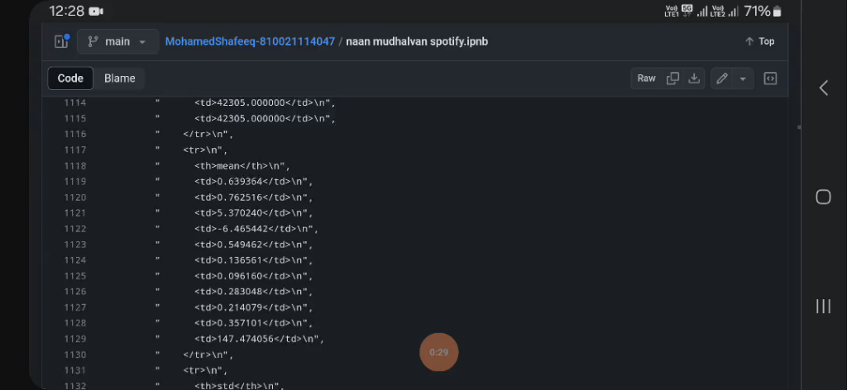
Project Demo(Recorded Video)
Presented By:
Mohamed Shafeeq A- au810021114047

Slide 8
Conclusion
The Spotify Music Recommendation System is a powerful tool that enhances user experience by providing personalized music recommendations tailored to individual preferences. Through advanced algorithms and machine learning techniques, Spotify analyzes user behavior, such as listening history, likes, and dislikes, to curate playlists and suggest songs that align with each user's taste.

Slide 9
Future Scope
The future scope for Spotify’s music recommendation system lies in several directions, driven by advancements in technology, data analytics, and user experience. Here are some potential avenues for development: Personalization through AI: Spotify can further enhance its recommendation system by leveraging advanced AI and machine learning techniques. This could involve more sophisticated algorithms that analyze user behavior, preferences, mood, context, and even physiological responses to music, providing highly tailored recommendations.

Slide 10
References
1) Project Github link, Ramar Bose,2024
2) Project video recorded link (youtube/github), Ramar Bose,2024
3) Project PPT & Report github link, Ramar Bose,2024

Slide 11
THANK YOU

